Slide 1
Twenty(ish) Tax Tips for Twenty-Twelve (2012)
Project Hired “JOB CLUB” 1/17/2012
Presented by Allan French,
Calif. Registered Tax Preparer
Edited to be a “work sample”; an explanation appears in the next slide

Slide 2
Explanation
The original version of this was created for my presentation to a job-seekers’ networking group, hosted by Project Hired, which is based in San Jose.
Only 12 slides are included here (less than half of the original presentation); enough so you’ll “get the feel of what was presented.”

Slide 3

If not stated otherwise, these comments apply to Federal taxes. California rules may be identical or different.
We’ll only cover a little bit in two hours. Free and low-cost resources will be cited, to help address questions after today.

Slide 4
Using a paid preparer vs. doing it yourself
  It is more “private” to do it yourself, but will take more time.
  Tax software has no value after you’ve done your return.
  By patronizing a local tax firm, you are supporting your community.
  Preparer can do a simple return in less than 20 minutes or a complex one in 30-45 minutes.
  Preparers use their own toner/ink/paper to print your documents.
  A professional is LESS LIKELY to make mistakes than you are.
  If the IRS or FTB has questions, the paid preparer can assist you in preparing an adequate response.

Slide 5
  IRS “Free-File” services
  NOTE: “Free-File” is not the same as “e-File.”
  Option #1: File by filling out your tax return online.
  Option # 2: Get a free copy of a name-brand tax software
  Your AGI must be less than $57,000 (whether single or married). There are other restrictions; see the IRS website (www.irs.gov)for details.
  California FTB has a similar filing service called “Cal-File.”

Slide 6
  Free in-person preparation for elderly, military, and people with low income
  VITA (“Volunteer Income Tax Assistance”)
    In Santa Clara County, it is sponsored by the United Way. See (www.211scc.org) and search for “VITA”.
  TCE (“Tax Counseling for the Elderly”)
    In northern Santa Clara County it is sponsored by the AARP. Get information at (www.aarp.org). Under the Money>>Taxes tab, look for “Tax Aide.”
  The IRS website also has VITA and TCE info.

Slide 7
An “IRS Enrolled Agent” is not an employee of the IRS, despite the title
  An enrolled agent (EA) is someone who know a lot about basic-level and intermediate-level income taxes.
  They are more knowledgeable about income tax than is an RTP (like me), but might not know much about certain specialized topics.
  An EA can represent a taxpayer in front of the IRS, acting almost like an attorney, if you are asked to appear in tax court.

Slide 8
ABCD-EIC: An overview of the most common tax schedules
  A = itemized deductions
  B = interest and dividends
  C = business income (except “hobby income,” which is reported directly on schedule 1040).
  D = capital gains and losses (due to sale of investments, collectibles, real estate, etc.)
  EIC = earned income credit
    A large tax credit for those who qualify.
    Because it is so lucrative, the IRS examines EIC claims VERY carefully.

Slide 9
Deductions and credits that are especially relevant to job seekers, students, and people with significant medical needs
  Moving expenses
  Travel costs associated with seeking a job
  Career coach / headhunter fees
  School tuition and fees
  Medical care costs
  Child and dependent care credit / child tax credit

Slide 10
What to bring to a tax-prep appointment
Photo ID for the taxpayer and spouse.
Social security cards for you, your spouse, and your dependents (A photocopy of a card is sufficient.)
For people not possessing a SS number, bring proof of an ITIN (Individual Taxpayer Identification Number), for you, your spouse, and dependents.
  This allows illegal residents to file income taxes. It also allows taxpayers to claim illegal aliens as dependents.
  The IRS is interested in collecting taxes – not finding illegal immigrants.
  The ITIN is issued by community nonprofits that interact with the IRS. This information is never shared with Immigration/ICE.
Birth dates for you, your spouse, and ALL dependents listed on the tax return.
Documents showing payments to you, or payments made by you. Most of these are labeled W2, K1, 1099, or 1098.
Name and address of your landlord, if you wish to claim renter’s credit.
Record of alimony paid or alimony received. (Child support is neither taxable nor deductible, but alimony is.)
Anything that you “think” might be relelvent. (Let the preparer decide for you.)
Total money paid to a daycare provider; their tax ID number; the provider's personal Social Security Number or business Employer Identification Number. You cannot deduct daycare expenses without identifying the provider.
A copy of last year’s federal and state tax returns if available. (Especially valuable if you are itemizing; if you had investment losses last year; or if you are using a new tax preparer.)
A check, to provide bank account routing number and account number, if you wish to use Direct Deposit. (A deposit slip will not do!)
To file taxes electronically on a married-filing-joint tax return, both spouses must be present to sign the required forms.

Slide 11
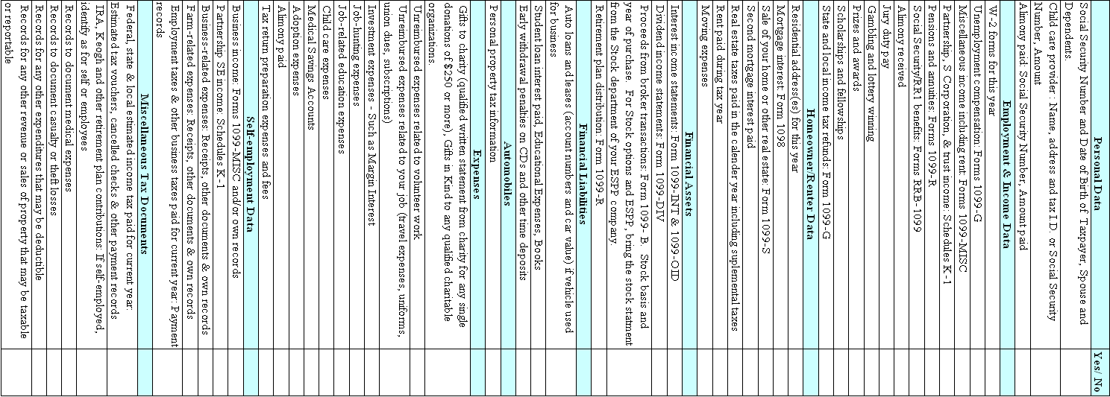
Tax Documents Checklist

Slide 12
(A whole lot of slides have been removed from this “sample” slideshow.)
-- The End --

